Slide 1
SS1 TEAM 7 Dynamic Programming
Janesse
Shi Han
Brandon
Liya
Recursive definition
Subgraph
DP Algorithm
P(C)
P(14) when n = 3
Algorithm & Code

Slide 2
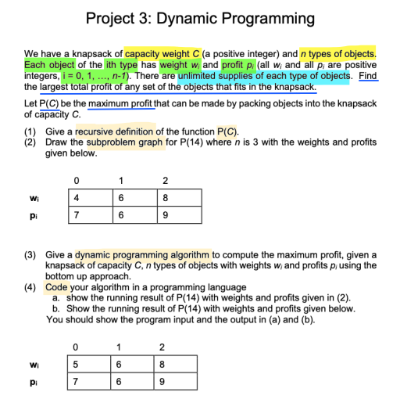
Notes:
Part a
implement algo
- time complexity graph
- key comparison graph
- find optimal S (& sample size)
Part b (Use optimal S)
Implement algo
Time complexity graph
Key comparison graph

Slide 3
Overview
Part (4)
4
Code
Part (3)
3
DP Algorithm
Part (2)
2
Subproblem Graph
Part (1)
Recursive definition for P(c)
1

Slide 4
(a)
Part (1)
Recursive definition for P(c)
1

Slide 5
Recursive definition for P(C)
P(C,0) = P(0,j) = 0
P(C, j) = max( P(C-iw_{j}, j-1) + ip_{j} , P(C, j-1) )
where 0 <= i <= floor(C/w_{j})

Slide 6
(b)
Part (2)
2
Subproblem Graph
Part (1)
Recursive definition for P(c)
1

Slide 7
(0,1)
(0,2)
Subproblem
Graph
(2,0)
(2,1)
(2,2)
P(14)
(4,0)
(4,1)
(6,0)
(6,1)
(6,2)
(6,3)
(8,0)
(8,1)
(8,2)
(10,0)
(10,1)
(14,0)
(14,1)
(14,2)
(14,3)

Slide 8
Part (3)
3
DP Algorithm
Part (2)
2
Subproblem Graph
Part (1)
Recursive definition for P(c)
1
Notes:
\

Slide 9

Compute maximum profit using bottom up approach
Draw the subproblem graph and find the dependencies among subproblems
Use a dictionary to store solutions to subproblem
Using an iterative function, solve the problem
Compute the solutions of subproblems of a problem first
Solution to P is computed based on the solutions to its subproblem and is stored into the dictionary (memorisation)

Slide 10
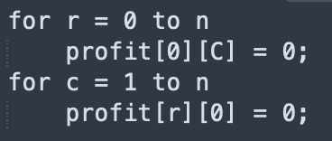
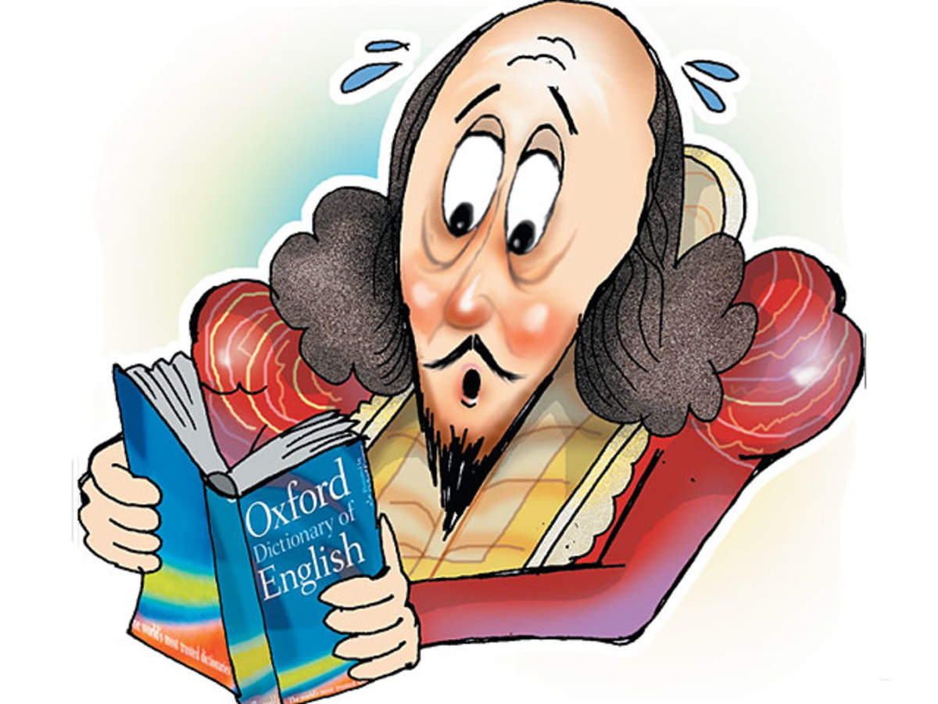
Dictionary: profit[C+1][n+1]
0 1 2
0 | 0 | 0
0
0
0
: 0 :
0
0
1
2
3
:
:
:
:
14
Notes:
for r = 0 to n
profit[0][C] = 0;
for c = 1 to n
profit[r][0] = 0;
for r = 1 to C
for c = 1 to n
For profit[r][c]:
- Consider if object type is in knapsack by comparing with profit[r][c-1]
- If object type is included, consider the different cases with varying number of objects
- Get maximum profit

Slide 11

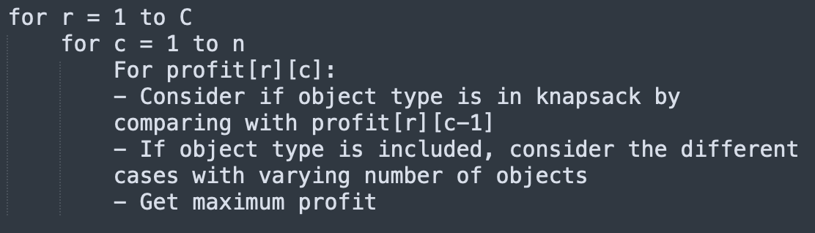
Idea

Slide 12
Part (4)
4
Code
Part (3)
3
DP Algorithm
Part (2)
2
Subproblem Graph
Part (1)
Recursive definition for P(c)
1

Slide 13
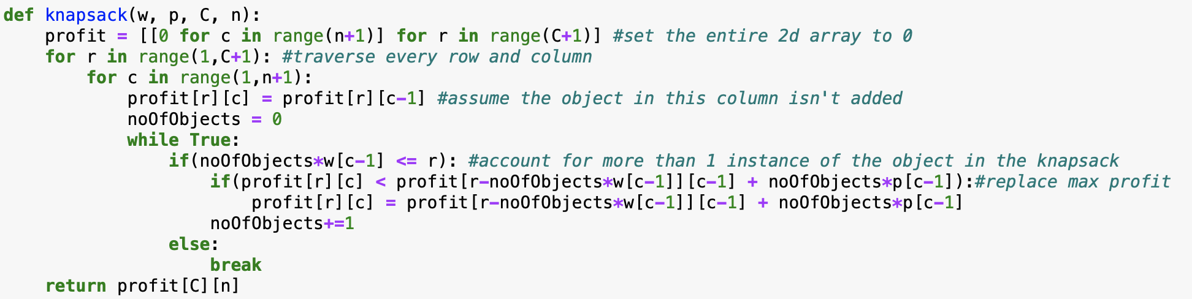
knapsack()

Slide 14
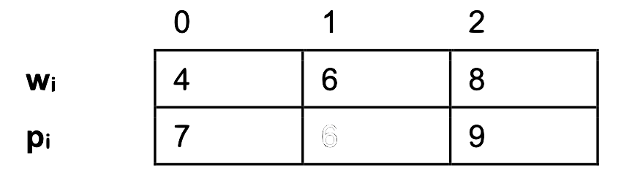
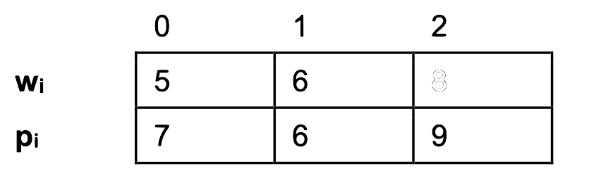
Subproblem - P(14)
Case A
6
Case B
8

Slide 15
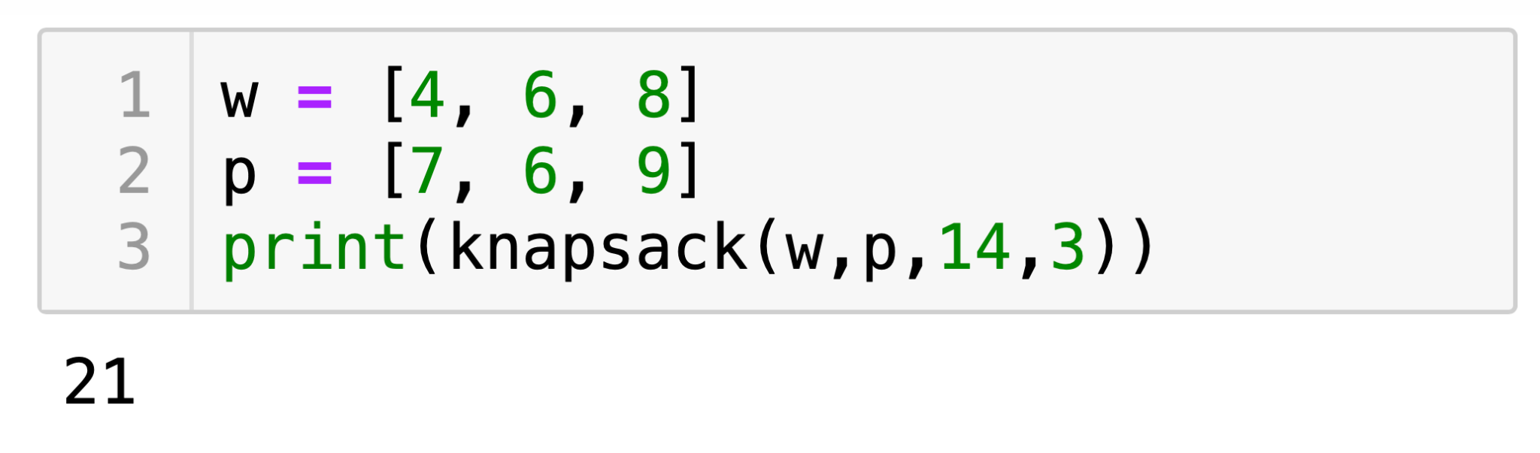
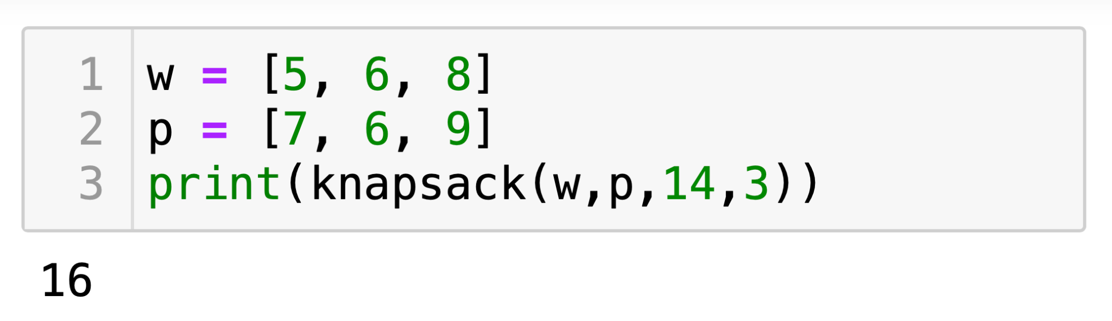
Subproblem Results - P(14)
Case A
6
Case B
8

Slide 16

END

